Slide 1
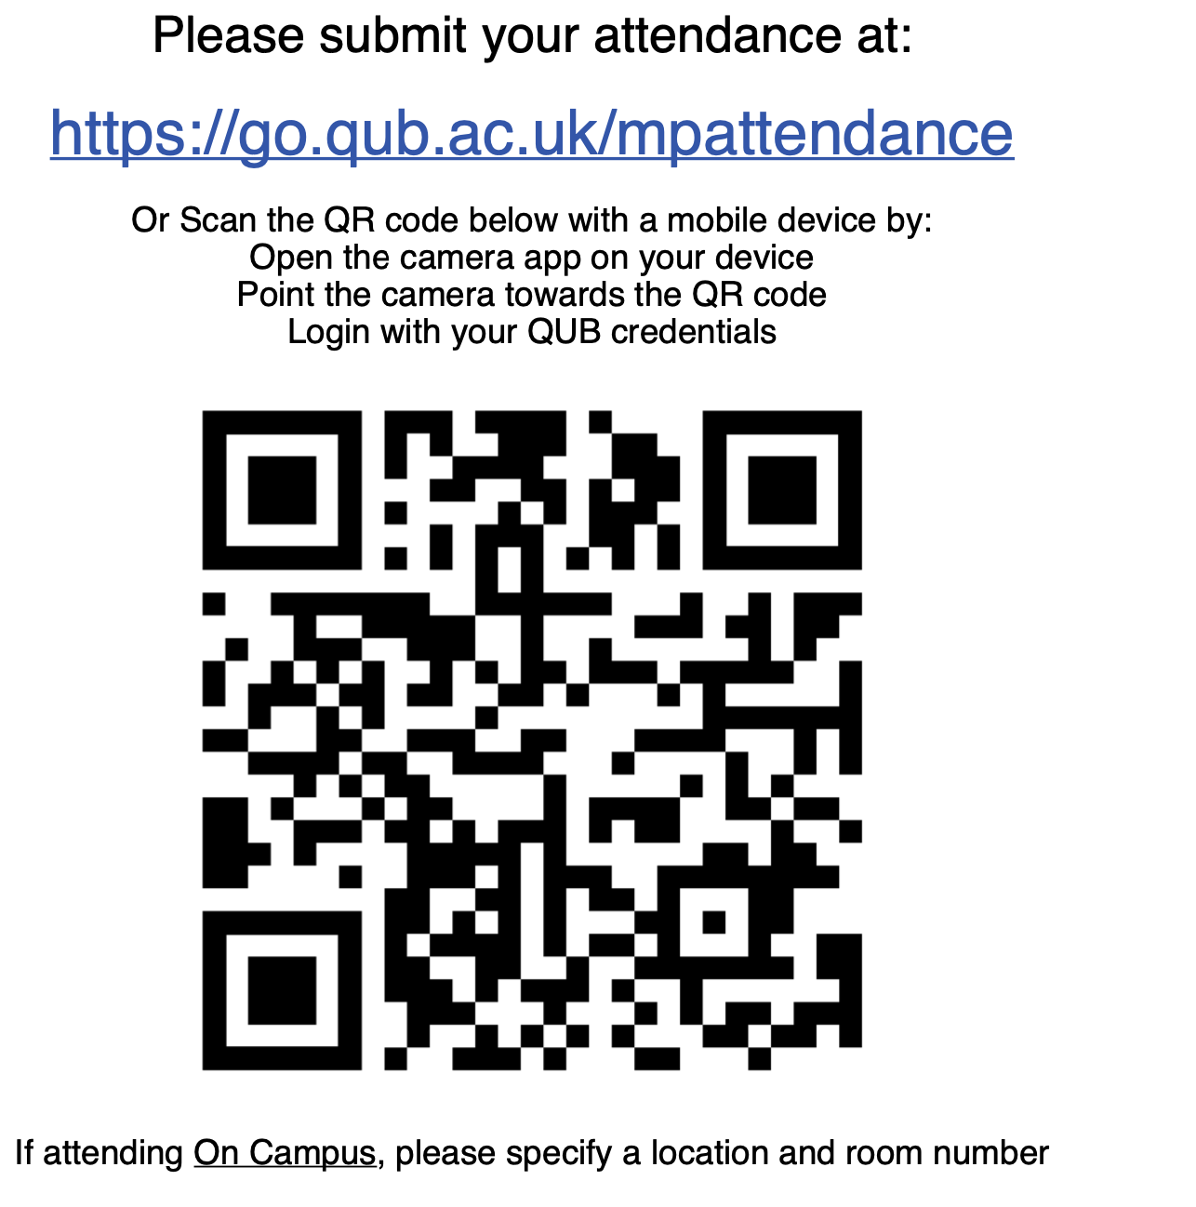


Padlet Link:
Password:
PHY2004
Socrative Link:
https://api.socrative.com/rc/5fvfh7

Slide 2

Assignment questions
For question 1 - What does it mean : “explain in which situations this form of the equations is most useful?”
Here I am looking for a comment which addresses the use of the macroscopic form of Maxwell’s equations, and the choice of differential form or integral form.
Deadline is Friday 11th March 22:00
Feedback will be provided by 28th March.
Dr. Charlotte Palmer/Prof. Gianluca Sarri

Slide 3
PHY2004: Electromagnetism and Optics
Lecture 14b:
Boundary conditions and the dispersion relation
Dr. Charlotte Palmer/Prof. Gianluca Sarri

Slide 4
Objectives
Boundary conditions of Maxwell’s equations for dielectric
Waves in conductors
Complex refractive index
Dispersion relation
Wave-packets - Group velocity and phase velocity
Anomalous dispersion
Dr. Charlotte Palmer/Prof. Gianluca Sarri

Slide 5
What if we have multiple wavelengths?
We have been using the plane wave solution of the wave equation:
But remember these waves are unphysical as they extend across all space and time.
However, we can combine plane wave solutions with different frequencies to create more realistic ‘light pulses’ or ‘wave packets’ with finite energy and finite extent in space.
Typically, we combine lots of frequencies within a spectral bandwidth around a central frequency. The wider our spectral bandwidth, the shorter the final wave-packet can be in time.
The shortest time duration for a wavepacket depends on the spectral bandwidth as the the time-bandwidth product which originates from the uncertainty principal.
Dr. Charlotte Palmer/Prof. Gianluca Sarri

Slide 6
Thought break:
Why do more frequencies let you make shorter pulses?
Dr. Charlotte Palmer/Prof. Gianluca Sarri
Notes:
https://api.socrative.com/rc/5fvfh7

Slide 7
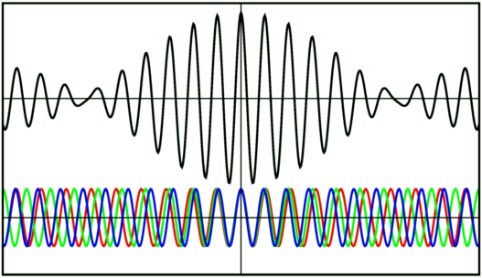
Thought break:
Why do more frequencies let you make shorter pulses?
From UCLA – Ned Wright
Dr. Charlotte Palmer/Prof. Gianluca Sarri
Notes:
https://api.socrative.com/rc/5fvfh7

Slide 8
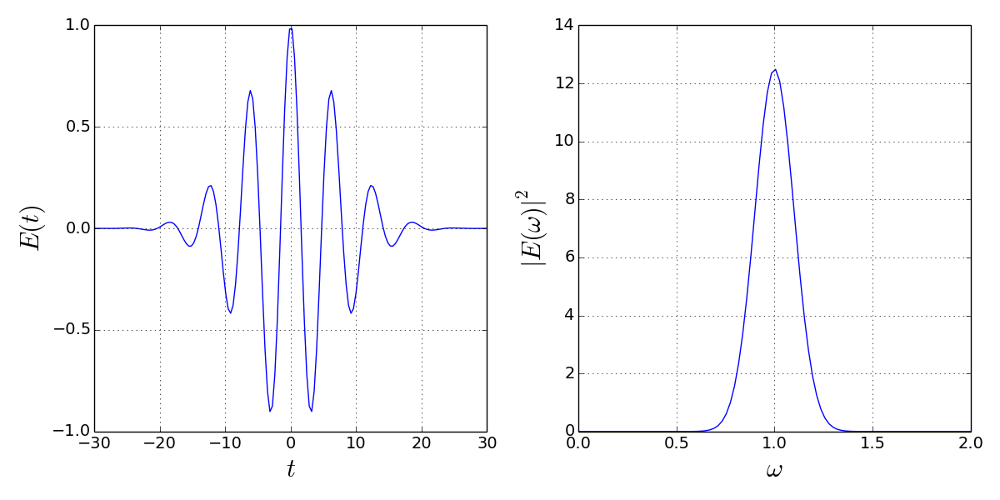
Wave-packet
Here is an example of a wave packet showing the oscillating electric field in time, with amplitude of the field varying as the pulse envelope.
Pulse envelope
Central frequency
Carrier
frequency
Bandwidth
Beatwave pattern
On the right you can see the spectrum of the light which has a central frequency and a bandwidth.
Dr. Charlotte Palmer/Prof. Gianluca Sarri

Slide 9
The simplest wave-packet
While the example contained a large number of frequencies we can create a simple wave-packet with just two: 𝜔₁ and 𝜔₂.
We start with two plane waves defined as before:
In this case the amplitude of each plane wave is the same but this is not generally true.
Because the angular frequency is different so is the magnitude of the wave vector
Any solutions of a linear differential equation can be added to create a new solution so we can just add our two plane waves.
Using the sum-to-product trigonometric identity:
We find,
Dr. Charlotte Palmer/Prof. Gianluca Sarri

Slide 10
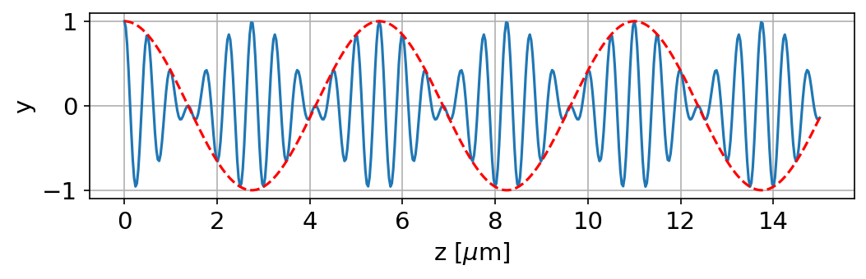
The simplest wave-packet
Average value of k: k₀
Average angular frequency: 𝜔₀
Bandwidth of frequencies around 𝜔₀
Bandwidth of k around k₀
Taking this into account we can rewrite this expression as:
This gives us two oscillations, one which governs the envelope and one which governs the internal oscillations.
Dr. Charlotte Palmer/Prof. Gianluca Sarri

Slide 11
Phase velocity and group velocity
If we follow this wave in time, we can see some complicated behaviour.
From Wikipedia – Phase velocity
The red dot is moving with a fixed phase position within the inner oscillation. This dot is moving at the phase velocity of the wave.
The green dots are positioned at the nodes of the envelope. This is the group velocity of the wave packet.
The phase velocity of the wave is given by:
The group velocity of the wave is given by:
If we take the limit of this, it becomes a differential:
Dr. Charlotte Palmer/Prof. Gianluca Sarri

Slide 12
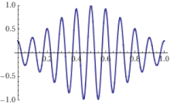
Phase velocity and group velocity
Phase velocity applies to a monochromatic plane wave while group velocity applies to a wave-packet. Their differences can lead to some really funky behaviour!
phase velocity:
group velocity:
From Wikipedia – Phase velocity
Dr. Charlotte Palmer/Prof. Gianluca Sarri

Slide 13
Group velocity, refractive index and dispersion
We have previously seen that the dispersion relation relates 𝜔 and k in different media.
Therefore we can use the dispersion relation to calculate both the phase velocity and group velocity of an electromagnetic wave.
Converting the differential to wavelength
Product rule
The group velocity depends on the variation of the phase velocity with wavelength, and therefore we can also see that the variation of the refractive index with wavelength is related to the group velocity.
Refractive index of a transparent medium
Dr. Charlotte Palmer/Prof. Gianluca Sarri

Slide 14
Normal Dispersion
We know that refractive index is a function of wavelength of the light as this is how we can split colours with a prism.
A, B, C .. are uniquely determined for the material
This dependency is typically expressed as:
Usually sufficiently accurate to include just these terms
n
Graph shows a typical (e.g. glass) variation of refractive index with wavelength often called normal dispersion:
The refractive index decreases with increasing wavelength/increases with increasing angular frequency.
λ
In a region of normal dispersion, group velocity is less than the phase velocity and phase velocity is less than c
Dr. Charlotte Palmer/Prof. Gianluca Sarri

Slide 15
Socrative 1:
For the case of normal dispersion which statement is True?
Red light is delayed relative to blue light
Blue light is delayed relative to red light
All light travels at c
All light travels at the same speed
Don’t know
Dr. Charlotte Palmer/Prof. Gianluca Sarri
Notes:
https://api.socrative.com/rc/5fvfh7

Slide 16
Cauchy expression
This is termed the Cauchy expression
It’s important to note that this formula is only valid for normal dispersion where we are far from absorption so can typically only be applied to IR and UV in normal materials – not for x-rays or for plasmas and metamaterials.
Dr. Charlotte Palmer/Prof. Gianluca Sarri

Slide 17

Microscopic theory
Dispersion is caused by the material response to different driving frequencies.
Materials are made from polarisable atoms and these atoms respond to incident electric fields by oscillating (primarily the electrons).
The charges will oscillate at the frequency of the driving wave and will emit radiation.
From MJVStreeter.Github.io/blog - Visualising radiation from accelerating charges
Dr. Charlotte Palmer/Prof. Gianluca Sarri

Slide 18
Microscopic theory
The waves emitted by the oscillating charges out of phase with the driving wave and this combines to create a new wave. This new wave has the same frequency but different velocity.
The charges can have some natural oscillation frequencies that depend on the material properties and other forces around the atoms.
When the frequency of the incident radiation matches, we can find resonances.
When atoms are oscillating resonantly their oscillation amplitude is large and the atoms can absorb significant energy from the wave.
We’re going to consider the parameters of the material exposed to an oscillating field to derive the refractive index.
Driving oscillating field:
Dr. Charlotte Palmer/Prof. Gianluca Sarri

Slide 19
Electron equation of motion
An electron in an external field will react classically to an oscillating electric field as a ‘Lorentz oscillator’ following this equation:
Note these both oppose the driving force so are negative
Force on an electron = driving force + damping force + spring force
The natural frequency of the electron oscillation is 𝜔₀
The frequency of the driving wave is 𝜔
Force on electron
Damping term depending on velocity
Restoring force
Force due driving electric field
Note: the oscillation of the electron is at the frequency of the driving wave
The solution to this equation is:
This is the displacement of the electron from its mean position
Dr. Charlotte Palmer/Prof. Gianluca Sarri

Slide 20
Complex dielectric constant
The dipole moment that will be induced on the atom will depend on this displacement of the electrons as:
We define the number of dipoles in a unit volume as N, so the total induced dipole moment will be:
By definition:
From this we can determine the relative permittivity of the material.
Like the wavevector we can describe this as a complex number separating the real and imaginary terms
Dr. Charlotte Palmer/Prof. Gianluca Sarri

Slide 21
Complex dielectric constant
The refractive index is defined in terms of the ratio of phase velocities and so for a dielectric we can write:
Also, in a non-magnetic material, 𝜇_{r} ~ 1 so,
We have also seen that we may have a complex refractive index that we express as:
We can relate this to our expression for relative permittivity of the material:
In this derivation, we’ve neglected the effect of neighbouring atoms so this is primarily valid for low density materials like rarefield gases.
Dr. Charlotte Palmer/Prof. Gianluca Sarri

Slide 22
Socrative 2:
What will happen if the driving frequency matches the natural frequency?
The oscillation will be cancelled
The oscillation amplitude will be enhanced
Energy will be transferred into the electron motion
There will be a resonance
Don’t know
Dr. Charlotte Palmer/Prof. Gianluca Sarri
Notes:
https://api.socrative.com/rc/5fvfh7

Slide 23
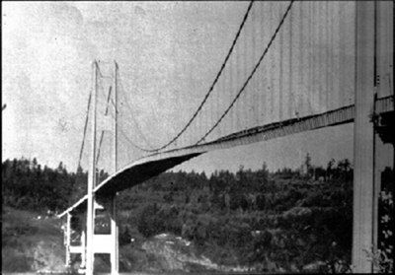
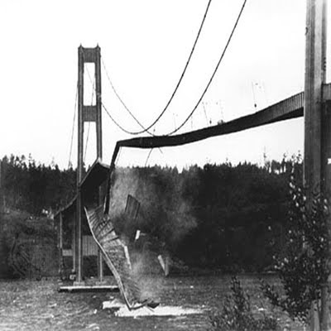
Resonance
If the frequency of the driving wave is exactly the same as the frequency with which the electron would oscillate in the molecule (ω₀)we will have resonance.
Formally, this occurs whenever a driving force is applied to a system with
the same frequency as the natural frequency of the system all across physics and typically corresponds to maximum absorption.
Dr. Charlotte Palmer/Prof. Gianluca Sarri

Slide 24
Resonant oscillations
If we have resonance then our polarization can be expressed as:
Therefore:
At resonance the imaginary component of the refractive index becomes significant.
Dr. Charlotte Palmer/Prof. Gianluca Sarri

Slide 25
Dispersion curve around absorption
When there is a resonance and significant absorption the shape of the refractive index curve changes from the family Cauchy expression (left).
n
Real component
Imaginary component
λ
This takes the form of a Lorentzian function.
Dr. Charlotte Palmer/Prof. Gianluca Sarri

Slide 26
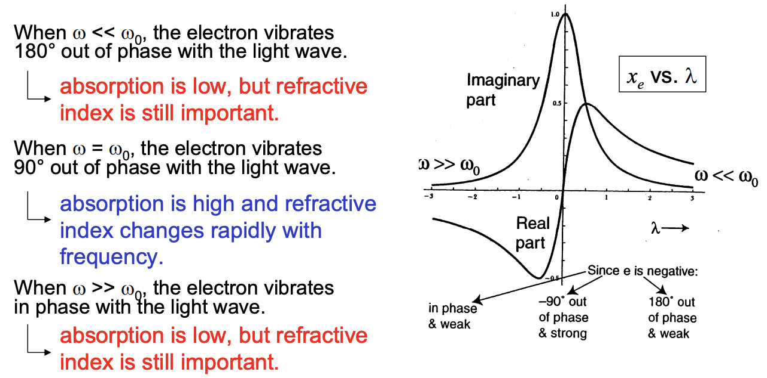
Dispersion curve around absorption
From Brown University: Daniel Mittleman
This change in gradient influences the group velocity of the electromagnetic wave.
Dr. Charlotte Palmer/Prof. Gianluca Sarri
Notes:
https://www.brown.edu/research/labs/mittleman/sites/brown.edu.research.labs.mittleman/files/uploads/lecture08_0.pdf

Slide 27
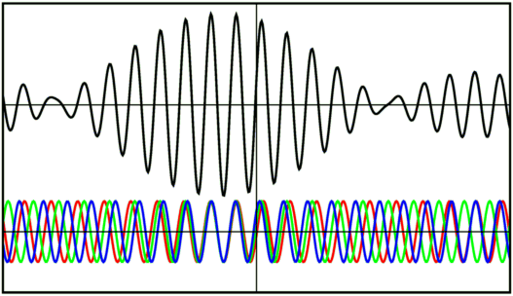
Superluminal light
When we are close to resonance we can have:
This implies that and
This is anomalous dispersion.
Remember: for normal dispersion
From UCLA - Ned Wright
It might appear that this contradicts special relativity (we have a velocity greater than the speed of light in a vacuum), but “signal velocity” the information that is contained by the wave is always travelling at less than c.
Dr. Charlotte Palmer/Prof. Gianluca Sarri
Notes:
Interesting analogies: https://physics.stackexchange.com/questions/6912/in-superluminal-phase-velocities-what-is-it-that-is-traveling-faster-than-light
Useful blog: https://ogden.eu/how-to-make-light-go-faster-than-light

Slide 28
Example group velocity question
Calculate the group velocity of light at a wavelength of 500 nm (in free space) when:
What is your first step?
Dr. Charlotte Palmer/Prof. Gianluca Sarri

Slide 29
Example group velocity question
1. Calculate the refractive index:
2. Calculate the phase velocity:
3. Differentiate the refractive index wrt wavelength:
4. Sub in values and calculate the group velocity.
Dr. Charlotte Palmer/Prof. Gianluca Sarri

Slide 30
Plane of incidence
We have seen that when light propagates across an interface between media the electric of magnetic field may be modified and this modification depends on the orientation of the field vector to the interface.
We have to be very clear about what our electric field components are perpendicular and parallel to. Often the plane of incidence is used instead of the plane of the interface.
Parallel to plane of incidence
Ray travels in the plane of incidence
Black arrows are both in the plane of incidence
E₁
Conditions in medium 1:
𝜀₁, 𝜇₁, n₁
Perpendicular to plane of incidence
interface
Conditions in medium 2:
𝜀₂, 𝜇₂, n₂
E₁
E₁
Dr. Charlotte Palmer/Prof. Gianluca Sarri

Slide 31

Socrative 3:
Which of these best defines the refractive index?
From Wikipedia – Refraction.
Ratio of the speed of light in a vacuum and in a medium.
Relative dielectric constant of a medium
Snell’s law
The angle of refraction
Don’t know
Dr. Charlotte Palmer/Prof. Gianluca Sarri
Notes:
https://api.socrative.com/rc/5fvfh7

Slide 32
Boundary conditions ex. : Snell’s law
Transmitted light is refracted and the angle of the transmitted light can be calculated via Snell’s law.
Remember the refractive index is determined by the relative phase velocity of the light in our medium and in vacuum so we typically picture this as associated with a decrease or increase in phase velocity of the wave across the interface.
But we can also derive it by considering our boundary conditions.
E_{i}
E_{r}
B_{i}
B_{r}
Conditions in medium 1:
𝜀₁, 𝜇₁, n₁
At the interface:
Note that the electric field in medium 1 include both the incident and reflected wave at the surface.
interface
Conditions in medium 2:
𝜀₂, 𝜇₂, n₂
E_{t}
B_{t}
Dr. Charlotte Palmer/Prof. Gianluca Sarri

Slide 33
Boundary conditions ex. : Snell’s law
Our general plane wave has the form:
Scalar quantity representing the phase of the wave at a particular point in space defined by r
Vector direction of electric field
Scalar quantity representing the phase of the wave at a particular point in time, t
Our boundary conditions tell us that the electric field parallel to the interface is equal on both sides at all points in space and in time.
For this to be true, the phase of the incident wave and transmitted wave must be equal at all points on the interface (and also the reflected wave).
E_{i}
E_{r}
B_{i}
B_{r}
Conditions in medium 1:
𝜀₁, 𝜇₁, n₁
interface
Components of k along the direction of r
Conditions in medium 2:
𝜀₂, 𝜇₂, n₂
E_{t}
Remember: Frequency of the light is not changed in different media.
B_{t}
Dr. Charlotte Palmer/Prof. Gianluca Sarri

Slide 34
Boundary conditions ex. : Snell’s law
The component of the electric field parallel with the interface is:
Considering our plane wave this is:
Since,
E_{i}
E_{r}
B_{i}
B_{r}
Conditions in medium 1:
𝜀₁, 𝜇₁, n₁
The total magnitude of the k is dependent on the material properties so although the component of k parallel with the surface ( ) is constant across the surface, the magnitude of k can change.
x
interface
Conditions in medium 2:
𝜀₂, 𝜇₂, n₂
E_{t}
B_{t}
Dr. Charlotte Palmer/Prof. Gianluca Sarri

Slide 35
Boundary conditions ex. : Snell’s law
In medium 1,
and in medium 2,
Since our components of k parallel with the interface must be equal we can write,
x
k₁
Substituting in for k and multiplying through by the vacuum phase velocity:
E_{i}
E_{r}
B_{i}
B_{r}
Conditions in medium 1:
𝜀₁, 𝜇₁, n₁
x
interface
Cancelling the constant wave frequency and substituting in the refractive index:
Conditions in medium 2:
𝜀₂, 𝜇₂, n₂
E_{t}
B_{t}
Dr. Charlotte Palmer/Prof. Gianluca Sarri

Slide 36
Socrative 1:
B_{r}
B_{i}
E_{r}
Which of these correctly describes our incident light?
E_{i}
A)
interface
B_{t}
B)
E_{t}
C)
E_{i}
E_{r}
E_{i}
E_{r}
B_{i}
B_{r}
B_{i}
B_{r}
interface
interface
E_{t}
E_{t}
B_{t}
B_{t}
Dr. Charlotte Palmer/Prof. Gianluca Sarri
Notes:
https://api.socrative.com/rc/5fvfh7

Slide 37
Fresnel reflectivity equations: S-polarisation
Decompose the electric and magnetic field into their components perpendicular and parallel to the plane of incidence.
E_{i}
E_{r}
B_{i}
B_{r}
interface
E_{t}
B_{t}
From the boundary conditions, we know that:
Our electric field is completely parallel with the interface so:
The magnetic field parallel with the interface would be expressed as :
Dr. Charlotte Palmer/Prof. Gianluca Sarri

Slide 38
Thought break
Why is it plus for one and minus for the other?
E_{i}
E_{r}
B_{i}
B_{r}
interface
E_{t}
B_{t}
Dr. Charlotte Palmer/Prof. Gianluca Sarri
Notes:
https://api.socrative.com/rc/5fvfh7

Slide 39
Fresnel reflectivity equations: S-polarisation
We also know that the amplitude of our electric and magnetic field is related via the phase velocity of the wave which we can express as the refractive index.
So we can use these equations to determine the relative amplitude of the whole electric field in reflection or transmission and the dependence on angle and refractive index.
From the magnetic field we have:
Substituting in:
And:
Dr. Charlotte Palmer/Prof. Gianluca Sarri

Slide 40
Fresnel reflectivity equations: S-polarisation
Now we can separate E_{i} and E_{r}
Relative magnitude of the reflected electric field when the incident electric field is:
- parallel with the interface
- perpendicular to the plane of incidence
- s-polarized.
Dr. Charlotte Palmer/Prof. Gianluca Sarri

Slide 41
Fresnel reflectivity equations: S-polarisation
If we now return to our original expressions we can look at the transmitted electric field.
We can substitute this into our expression relating the transmitted and refracted rays.
To give us,
Again gathering our terms for the incident and transmitted electric field:
Relative magnitude of the transmitted electric field when the incident electric field is perpendicular to the plane of incidence
Dr. Charlotte Palmer/Prof. Gianluca Sarri

Slide 42
Fresnel reflectivity equations: P-polarisation
Decompose the electric and magnetic field into their components perpendicular and parallel to the plane of incidence.
E_{i}
E_{r}
B_{i}
B_{r}
interface
E_{t}
B_{t}
From the boundary conditions, we still have:
Our magnetic field is completely parallel with the interface so:
Now the electric field parallel with the interface would be expressed as :
Dr. Charlotte Palmer/Prof. Gianluca Sarri

Slide 43
Fresnel reflectivity equations: P-polarisation
Substituting into
We can now substitute this into our expression for the electric field component parallel with the interface:
Dr. Charlotte Palmer/Prof. Gianluca Sarri

Slide 44
Fresnel reflectivity equations: P-polarisation
Now we can separate E_{i} and E_{r} as we did before:
Relative magnitude of the reflected electric field when the incident electric field:
- Has components perpendicular with the interface
- Is parallel to the plane of incidence
- Is p-polarized.
Dr. Charlotte Palmer/Prof. Gianluca Sarri

Slide 45
Fresnel reflectivity equations: P-polarisation
If we now return to our original expressions we can look at the transmitted electric field.
We can substitute this into our expression relating the transmitted and refracted rays.
To give us,
Again gathering our terms for the incident and transmitted electric field:
Relative magnitude of the transmitted electric field when the incident electric field is perpendicular to the plane of incidence
Dr. Charlotte Palmer/Prof. Gianluca Sarri

Slide 46
Fresnel equations at normal incidence
At normal incidence the angle between the surface normal and the incident ray is 0º and there is no refraction so the transmitted angle is also 0º .
We can use this to simplify the s-polarization Fresnel equations to the form below:
Note: There is no such thing as p-polarization at normal incidence.
Dr. Charlotte Palmer/Prof. Gianluca Sarri

Slide 47
Reflected and transmitted intensity
The Fresnel equations gives us the ratio of electric field strengths but the ‘intensity’ of the light is often more useful.
The intensity is the energy per unit time, per unit area – this scalar quantity is linked to the Poynting vector and it’s never negative.
From this you can see the ratio of the transmitted and reflected intensities of light will be the square of the Fresnel ratio.
Refractive index glass = 1.5
For normal incidence
Refractive index air = 1.0
Dr. Charlotte Palmer/Prof. Gianluca Sarri

Slide 48
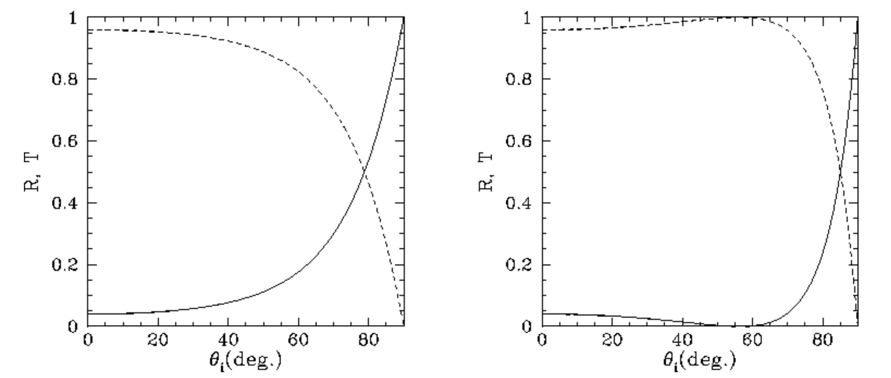
Fresnel reflections
Reflection and transmission factors depend on angle of incidence and on the plane of polarization of the light.
S-polarized:
Electric field is perpendicular to plane of incidence
P-polarized:
Electric field parallel to plane of incidence
From University of Texas EM course
From this we can see that at some angles we can split the incident light into two equal components.
Dr. Charlotte Palmer/Prof. Gianluca Sarri

